Slide 1
Association Rule Learning
Apriori Algorithm

Slide 2
Mining of association rules is a fundamental data mining task
It is perhaps the most important model invented and extensively studied by the database and data mining community.
Its objective is to find all co-occurrence relationships, called associations, among data items.
introduced in 1993 by Agrawal et al. for finding frequent itemsets in a dataset to generate association rules

Slide 3
The classic application of association rule mining is the market basket data analysis, which aims to discover how items purchased by customers in a supermarket (or a store) are associated.
An example association rule is
Cheese → Beer [support = 10%, confidence = 80%]
The rule says that 10% customers buy Cheese and Beer together, and those who buy Cheese also buy Beer 80% of the time.
Support and confidence are two measures of rule strength.

Slide 4
This mining model is in fact very general and can be used in many applications.
For example, in the context of the Web and text documents, it can be used to find word co-occurrence relationships and Web usage patterns
Association rule mining, however, does not consider the sequence in which the items are purchased.
Sequential pattern mining takes care of that.

Slide 5
An example of a sequential pattern is “5% of customers buy bed first, then mattress and then pillows”
The items are not purchased at the same time, but one after another.
Such patterns are useful in Web usage mining for analyzing clickstreams from server logs.
They are also useful for finding language or linguistic patterns from natural language texts.

Slide 6
Association Rule Mining
As the name suggests, association rules are simple If/Then statements
Most machine learning algorithms work with numeric datasets and hence tend to be mathematical.
However, association rule mining is suitable for non-numeric, categorical data and requires just a little bit more than simple counting.
Association rule mining is a procedure which aims to observe frequently occurring patterns, correlations, or associations from datasets found in various kinds of databases such as relational databases, transactional databases, and other forms of repositories.

Slide 7
Rule
An association rule has 2 parts
an antecedent (if) and
a consequent (then)

Slide 8
Association Rule Mining
is given by R. Agrawal and R. Srikant in 1994 for finding frequent itemsets in a dataset to generate association rules
With the help of these association rule, it determines how strongly or how weakly two objects are connected.
Name of the algorithm is Apriori because it uses prior knowledge of frequent itemset properties.
Useful for retail businesses or any type of e-commerce
In short, Frequent Mining shows which items appear together in a transaction or relation.
People who bought also bought….

Slide 9
Need of Association Mining
Frequent mining is generation of association rules from a Transactional Dataset.
If there are 2 items X and Y purchased frequently then its good to put them together in stores or provide some discount offer on one item on purchase of other item.
This can really increase the sales.
For example it is likely to find that if a customer buys Milk and bread he/she also buys Butter.
So the association rule is [‘milk]^[‘bread’]=>[‘butter’].
So seller can suggest the customer to buy butter if he/she buys Milk and Bread.

Slide 10
Applications
Market Basket Analysis
Medical Diagnosis
It can also be used in the healthcare field to find
the probability of the occurrence of illness concerning various factors and symptoms.
drug reactions for patients.
Census Data
This data can be used to plan efficient public services(education, health, transport) as well as help public businesses (for setting up new factories, shopping malls, and even marketing particular products).
Catalog design

Slide 11
ARL- Movie Recommendation
Potential Rules:
Movie 1 Movie 2
Movie 2 Movie 4
Movie 1 Movie 3
User ID | Movies Liked
12134 | Movie1, Movie2, Movie3, Movie4
43255 | Movie1, Movie2
14324 | Movie1, Movie2, Movie4
64346 | Movie1, Movie2
13435 | Movie2, Movie4
25235 | Movie1, Movie3
We can come up with lots of interpretation rules.
Some of them may be weaker while some others may be stronger
And we want to find the very strong ones in order to build our business decisions/other decisions based on rule that we see in our data.

Slide 12
ARL- Market basket optimization
Transaction ID | Product Purchased
12134 | Burgers, French fries, vegetables
43255 | Burgers, French fries, Ketchup
14324 | Vegetables, fruits
64346 | Pasta, Fruits, Butter, vegetable
13435 | Burgers, Pasta, French fries
25235 | Fruits, Orange Juice, Vegetables
Association Rule Mining is sometimes referred to as “Market Basket Analysis” as it was the first application area of association mining.
Potential Rules:
Burgers French fries
Vegetables fruits
Burgers, French fries Ketchup

Slide 13
Market basket Analysis
Suppose an X store’s retail transactions database includes the following data:
Total number of transactions: 600,000
Transactions containing diapers: 7,500 (1.25 percent)
Transactions containing beer: 60,000 (10 percent)
Transactions containing both beer and diapers: 6,000 (1.0 percent)
From the above figures, we can conclude that if there was no relation between beer and diapers (that is, they were statistically independent), then we would have got only 10% of diaper purchasers to buy beer too.
However, as surprising as it may seem, the figures tell us that 80% (=6000/7500) of the people who buy diapers also buy beer. This is a significant jump of 8 over what was the expected probability. This factor of increase is known as Lift – which is the ratio of the observed frequency of co-occurrence of our items and the expected frequency.

Slide 14
Support
Count(X)
Number of transactions in which X appears.
If X is A union B then it is the number of transactions in which A and B both are present.
Support (X, Y)
((Count(XUY)) / (Total # of records))
Support is a useful measure because if it is too low, the rule may just occur due to chance.
Furthermore, in a business environment, a rule covering too few cases (or transactions) may not be useful because it does not make business sense to act on such a rule (not profitable).

Slide 15
Confidence
Support (X->Y)
Count(XUY)) /n XUY= union of sets A and B or Both A and B
Confidence (X->Y)
is the percentage of transactions in T that contain X also contain Y, and can be seen as an estimate of the conditional probability, Pr(Y | X).
Count(XUY)) / (Count(X)
Confidence thus determines the predictability of the rule.
If the confidence of a rule is too low, one cannot reliably infer or predict Y from X. A rule with low predictability is of limited use.
Lift
Lift (X => Y) = Confidence(X => Y) / Support(Y)

Slide 16
Support & Confidence: Example
computer ⇒ antivirus software [support = 2%,confidence = 60%].
A support of 2% means that 2% of all the transactions under analysis show that computer and antivirus software are purchased together.
A confidence of 60% means that 60% of the customers who purchased a computer also bought the software.
Typically, association rules are considered interesting if they satisfy both a minimum support threshold and a minimum confidence threshold.
These thresholds can be a set by users or domain experts.

Slide 17
Example
An example of a transaction set
t1: Beef, Chicken, Milk
t2: Beef, Cheese
t3: Cheese, Boots
t4: Beef, Chicken, Cheese
t5: Beef, Chicken, Clothes, Cheese, Milk
t6: Chicken, Clothes, Milk
t7: Chicken, Milk, Clothes
Given the user-specified minsup = 30% and minconf = 80%,
the following association rule is valid as its support is 42.84% (> 30%) and its confidence is 100% (> 80%)
Chicken, Clothes → Milk [sup = 3/7, conf = 3/3].
The rule below is also valid
Clothes → Milk, Chicken [sup = 3/7, conf = 3/3]
Clearly, more association rules can be discovered

Slide 18
Another Application
We also note that a text document or even a sentence in a single document can be treated as a transaction without considering word sequence and the number of occurrences of each word.
Hence, given a set of documents or a set of sentences, we can find word co-occurrence relations.

Slide 19
Itemset
A set of items is referred to as an itemset.
An itemset that contains k items is a k-itemset.

Slide 20
Frequent Itemset
Frequent itemsets are those itemsets whose support is greater than the threshold value or user-specified minimum support.
It means if A & B are the frequent itemsets together, then individually A and B should also be the frequent itemset.

Slide 21
Objective
1. Find all frequent itemsets:
each of these itemsets will occur at least as frequently as a predetermined minimum support count, min sup.
2. Generate strong association rules from the frequent itemsets:
these rules must satisfy minimum support and minimum confidence.
the second step is much less costly than the first, the overall performance of mining association rules is determined by the first step.

Slide 22
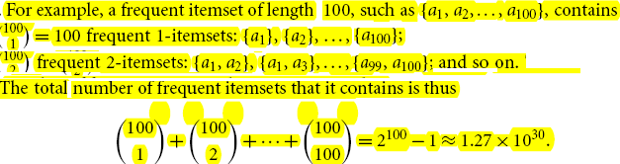
A major challenge in mining frequent itemsets from a large data set
such mining often generates a huge number of itemsets satisfying the minimum support (min sup) threshold, especially when min sup is set low.
This is because if an itemset is frequent, each of its subsets is frequent as well.
A long itemset will contain a combinatorial number of shorter, frequent sub-itemsets.

Slide 23
This is too huge a number of itemsets for any computer to compute or store.
To overcome this difficulty, we introduce the concepts of closed frequent itemset and maximal frequent itemset.

Slide 24
Frequent Itemset Mining Methods
Apriori
FP Growth

Slide 25
Apriori Algorithm
Apriori is a seminal algorithm proposed by R. Agrawal and R. Srikant in 1994 for mining frequent itemsets for Boolean association rules
Algorithm
1. Set a minimum support and confidence
2. Determine the support of all itemsets in the transactional database
3. Take all the subsets in transactions having higher support than minimum support
4. Take all the rules of these subsets having higher confidence than minimum confidence
5. sort the rules by decreasing order of lift

Slide 26
Apriori Algorithm
The name of the algorithm is based on the fact that the algorithm uses prior knowledge of frequent itemset properties
Apriori employs an iterative approach known as a level-wise search, where k-itemsets are used to explore (k+1) itemsets.
First, the set of frequent 1-itemsets is found by scanning the database to accumulate the count for each item, and collecting those items that satisfy minimum support.
The resulting set is denoted by L1.
Next, L1 is used to find L2, the set of frequent 2-itemsets, which is used to find L3, and so on, until no more frequent k-itemsets can be found.
The finding of each Lk requires one full scan of the database.

Slide 27
Boolean/Quantitative rules
If a rule involves associations between the presence or absence of items, it is a Boolean association rule.
For examples
Computer => antivirus software [support = 2%; confidence = 60%]
buys(X,”computer”)=>buys(X,”HP printer”)
buys(X,”laptop computer”)=>buys(X,”HP printer”)
Quantitative association rules involve numeric attributes that have an implicit ordering among values (e.g., age).
If a rule describes associations between quantitative items or attributes, then it is a quantitative association rule.
In these rules, quantitative values for items or attributes are partitioned into intervals.
Example
age( X, “30…39″) ^income(X,”42K…48K”)=> buys(X,”high resolution TV”)
Note that the quantitative attributes, age and income, have been discretized

Slide 28
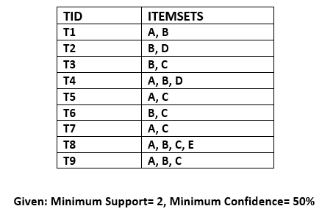
Example: dataset that has various transactions
find the frequent itemsets and
generate the association rules using the Apriori algorithm

Slide 29
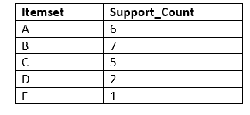
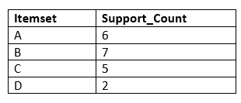
Step-1: Calculating C1 and L1
create a table that contains support count (The frequency of each itemset individually in the dataset) of each itemset in the given dataset.
This table is called the Candidate set or C1.
take out all the itemsets that have the greater support count that the Minimum Support (2).
It will give us the table for the frequent itemset L1.

Slide 30
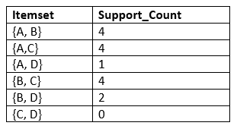
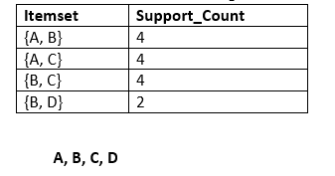
Step-2: Candidate Generation C2, and L2
generate C2 with the help of L1.
In C2, we will create the pair of the itemsets of L1 in the form of subsets.
After creating the subsets, we will again find the support count from the main transaction table of datasets, i.e., how many times these pairs have occurred together in the given dataset.
Generate L2
compare the C2 Support count with the minimum support count, and after comparing, the itemset with less support count will be eliminated from the table C2.

Slide 31
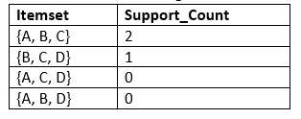
Step-3: Candidate generation C3, and L3
For C3,
we will repeat the same two processes, with subsets of three itemsets together, and will calculate the support count from the dataset.
create the L3 table.
As we can see from the above C3 table, there is only one combination of itemset that has support count equal to the minimum support count. So, the L3 will have only one combination, i.e., {A, B, C}.

Slide 32
Step-4: Finding the association rules for the subsets
To generate the association rules, first, create a new table with the possible rules from the occurred combination f={A, B.C}.
For all the rules, calculate the Confidence
exclude the rules that have less confidence than the minimum threshold(50%).
Rules | Support | Confidence
A^B->C | 2 | Sup{(A ^B) ^C}/sup(A ^B)= 2/4=0.5=50%
B^C->A | 2 | Sup{(B^C) ^A}/sup(B ^C)= 2/4=0.5=50%
A^C->B | 2 | Sup{(A ^C) ^B}/sup(A ^C)= 2/4=0.5=50%
C-> A^B | 2 | Sup{(C^( A ^B)}/sup(C)= 2/5=0.4=40%
A->B^C | 2 | Sup{(A^( B ^C)}/sup(A)= 2/6=0.33=33.33%
B->A^C | 2 | Sup{(B^( B ^C)}/sup(B)= 2/7=0.28=28%

Slide 33
Apriori principle
To improve the efficiency of the level-wise generation of frequent itemsets, an important property called the Apriori property or downward closure property is used to reduce the search space.
Downward closure property: If an itemset has minimum support, then every non-empty subset of this itemset also has minimum support.
Any subset of a frequent itemset must be frequent
No superset of any infrequent itemset should be generated or tested
Many item combinations can be pruned
How is the Apriori property used in the algorithm
To understand this, let us look at how Lk−1 is used to find Lk for k ≥ 2.
A two-step process is followed, consisting of join and prune actions

Slide 34
The join step
To find Lk , a set of candidate k-itemsets is generated by joining Lk−1 with itself.
This set of candidates is denoted Ck .
Let l1 and l2 be itemsets in Lk−1.
The notation li[j] refers to the jth item in li
(e.g., l1[k − 2] refers to the second to the last item in l1).
For efficient implementation, Apriori assumes that items within a transaction or itemset are sorted in lexicographic order.
For the (k − 1)-itemset, li , this means that the items are sorted such that li[1] < li[2] < ··· < li[k − 1].
The join, Lk−1 ⨝ Lk−1, is performed, where members of Lk−1 are joinable if their first (k − 2) items are in common.
That is, members l1 and l2 of Lk−1 are joined if (l1[1] = l2[1]) ∧ (l1[2] = l2[2]) ∧ ··· ∧ (l1[k − 2] = l2[k − 2]) ∧(l1[k − 1] < l2[k − 1]).
The condition l1[k − 1] < l2[k − 1] simply ensures that no duplicates are generated.
The resulting itemset formed by joining l1 and l2 is {l1[1], l1[2],..., l1[k − 2], l1[k − 1], l2[k − 1]}.

Slide 35
The prune step
Ck is a superset of Lk, that is, its members may or may not be frequent, but all of the frequent k-itemsets are included in Ck .
A database scan to determine the count of each candidate in Ck would result in the determination of Lk (i.e., all candidates having a count no less than the minimum support count are frequent by definition, and therefore belong to Lk).
Ck, however, can be huge, and so this could involve heavy computation.
To reduce the size of Ck , the Apriori propertyis used as follows. Any (k − 1)-itemset that is not frequent cannot be a subset of a frequent k-itemset.
Hence, if any (k − 1)-subset of a candidate k-itemset is not in Lk−1, then the candidate cannot be frequent either and so can be removed from Ck .
This subset testing can be done quickly by maintaining a hash tree of all frequent itemsets.

Slide 36
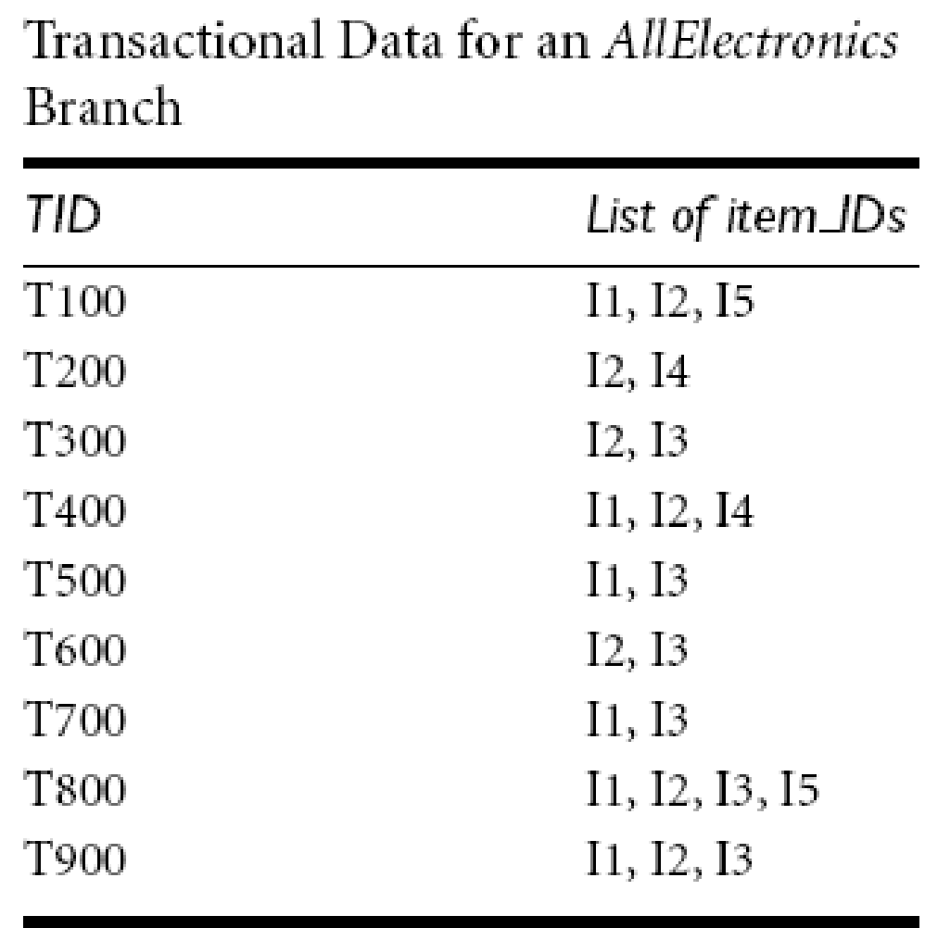
Example
Find frequent itemsets in D

Slide 37
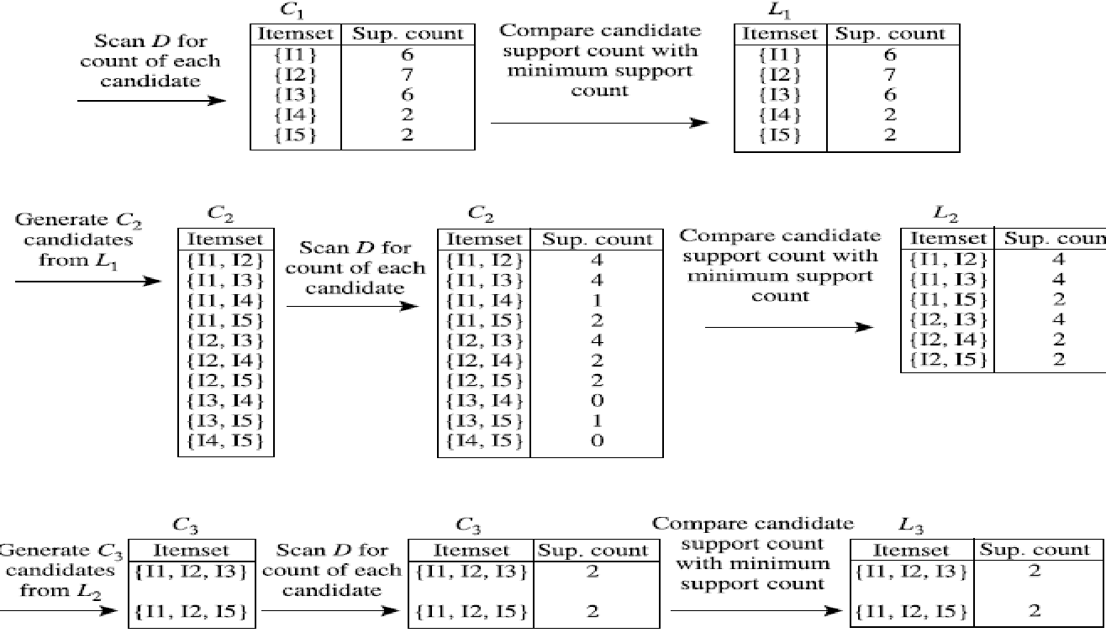

Slide 38
Steps
Step 1
In the first iteration of the algorithm, each item is a member of the set of candidate 1-itemsets, C1.
The algorithm simply scans all of the transactions to count the number of occurrences of each item.
Step 2
Suppose that the minimum support count required is 2, that is, min sup = 2. (Here, we are referring to absolute support because we are using a support count. The corresponding relative support is 2/9 = 22%.)
The set of frequent 1-itemsets, L1, can then be determined.
It consists of the candidate 1-itemsets satisfying minimum support.
In our example, all of the candidates in C1 satisfy minimum support.

Slide 39
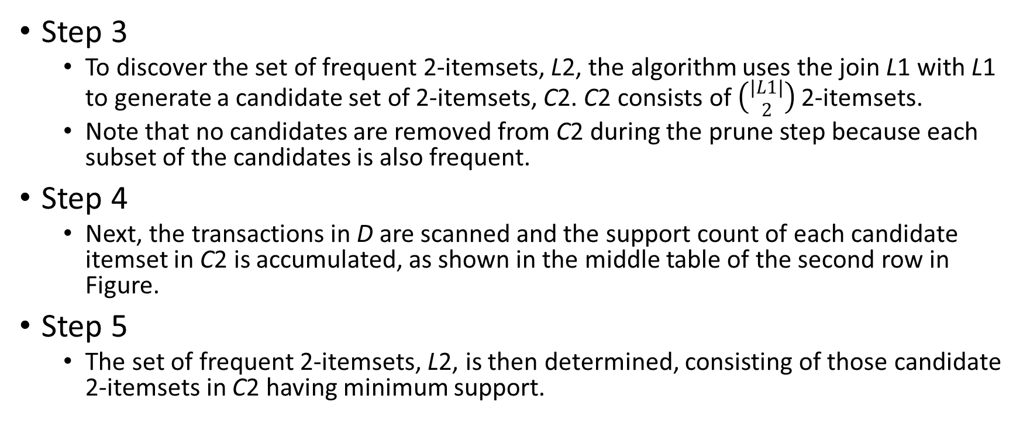
Steps

Slide 40
Step 6
The generation of the set of the candidate 3-itemsets, C3, is detailed in Figure.
From the join step, we first get C3 = L2 ⨝ L2 = {{I1, I2, I3}, {I1, I2, I5}, {I1, I3, I5}, {I2, I3, I4}, {I2, I3, I5}, {I2, I4, I5}}.
Based on the Apriori property that all subsets of a frequent itemset must also be frequent, we can determine that the four latter candidates cannot possibly be frequent.
We therefore remove them from C3, thereby saving the effort of unnecessarily obtaining their counts during the subsequent scan of D to determine L3.
Note that when given a candidate k-itemset, we only need to check if its (k -1) -subsets are frequent since the Apriori algorithm uses a level-wise search strategy.
The resulting pruned version of C3 is shown in the first table of the bottom row of Figure.

Slide 41
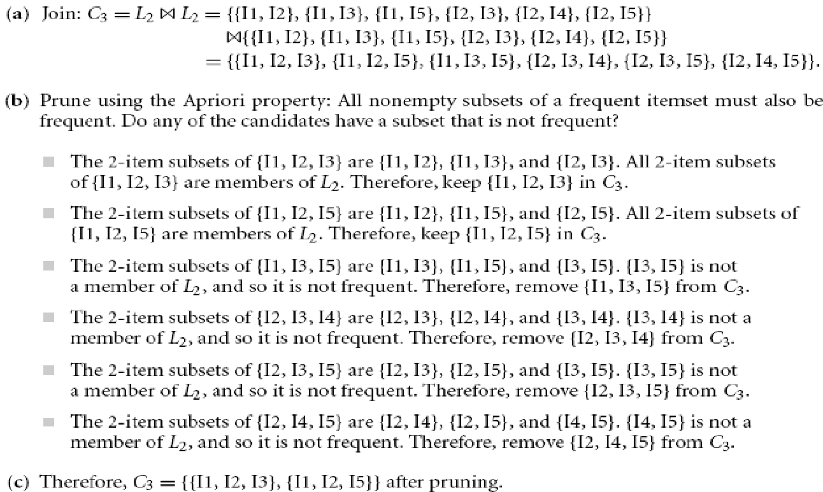

Slide 42
Steps
Step 7
The transactions in D are scanned to determine L3, consisting of those candidate
3-itemsets in C3 having minimum support (Figure).
Step 8
The algorithm uses L3 ⨝ L3 to generate a candidate set of 4-itemsets, C4. Although
the join results in {{I1, I2, I3, I5}}, itemset {I1, I2, I3, I5} is pruned because its subset {I2, I3, I5} is not frequent.
Thus, C4 = Φ , and the algorithm terminates, having found all of the frequent itemsets.

Slide 43
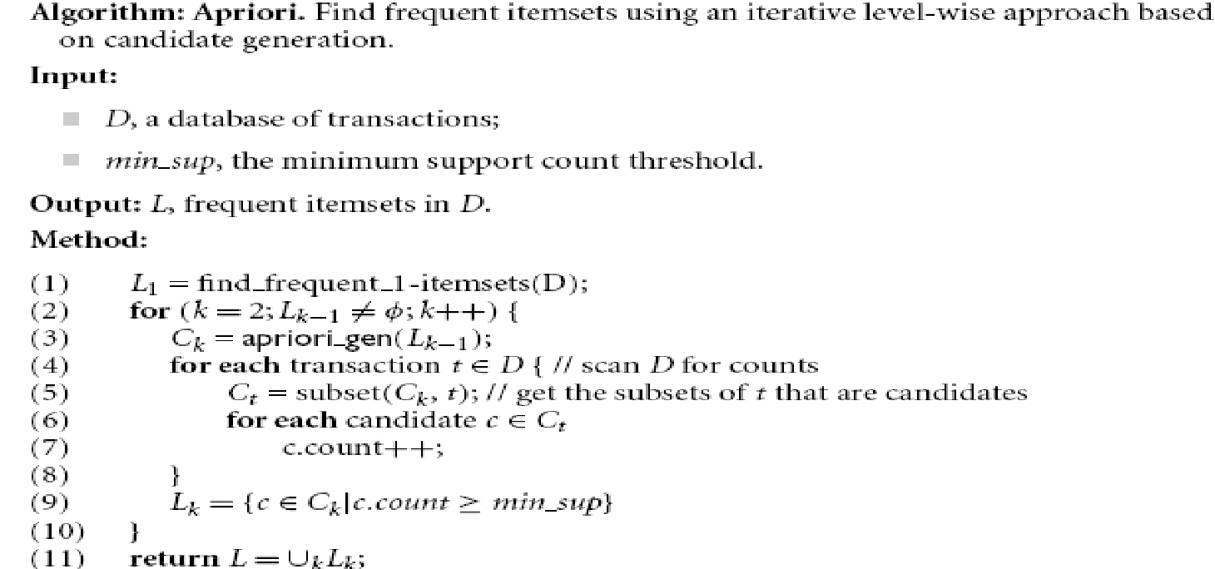
pseudocode

Slide 44
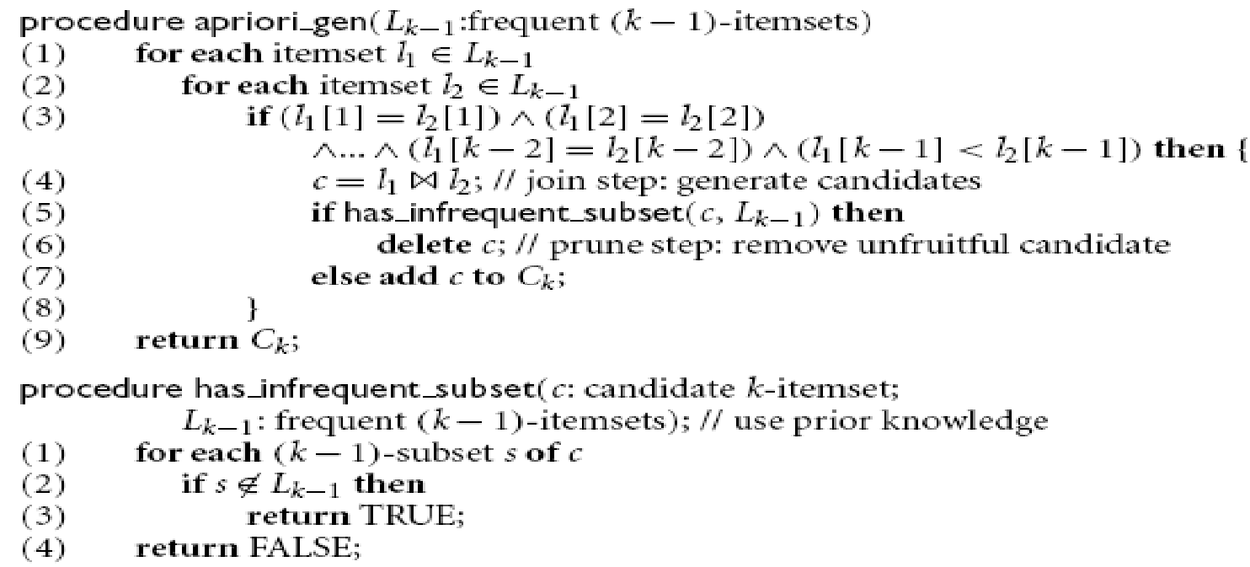

Slide 45
Explanation of pseudocode
Step 1 of Apriori finds the frequent 1-itemsets, L1. In steps 2 through 10, Lk-1 is used to generate candidates Ck to find Lk for k 2.
The apriori gen procedure generates the candidates and then uses the Apriori property to eliminate those having a subset that is not frequent (step 3).
This procedure is described later.
Once all of the candidates have been generated, the database is scanned (step 4).
For each transaction, a subset function is used to find all subsets of the transaction that are candidates (step 5), and the count for each of these candidates is accumulated (steps 6 and 7).
Finally, all the candidates satisfying the minimum support (step 9) form the set of frequent itemsets, L (step 11).
The apriori gen procedure performs two kinds of actions, namely, join and prune, as described before.
In the join component, Lk-1 is joined with Lk-1 to generate potential candidates (steps 1–4).
The prune component (steps 5–7) employs the Apriori property to remove candidates that have a subset that is not frequent.
The test for infrequent subsets is shown in procedure has infrequent subset.

Slide 46
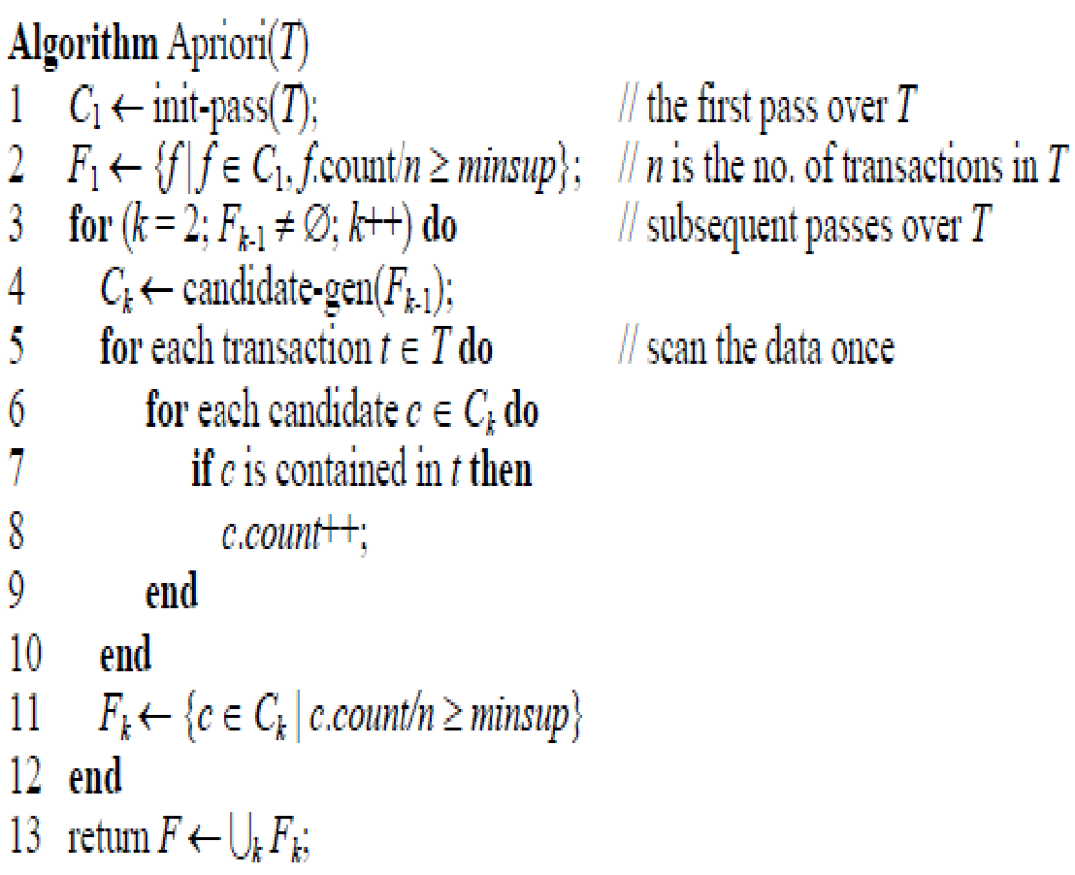
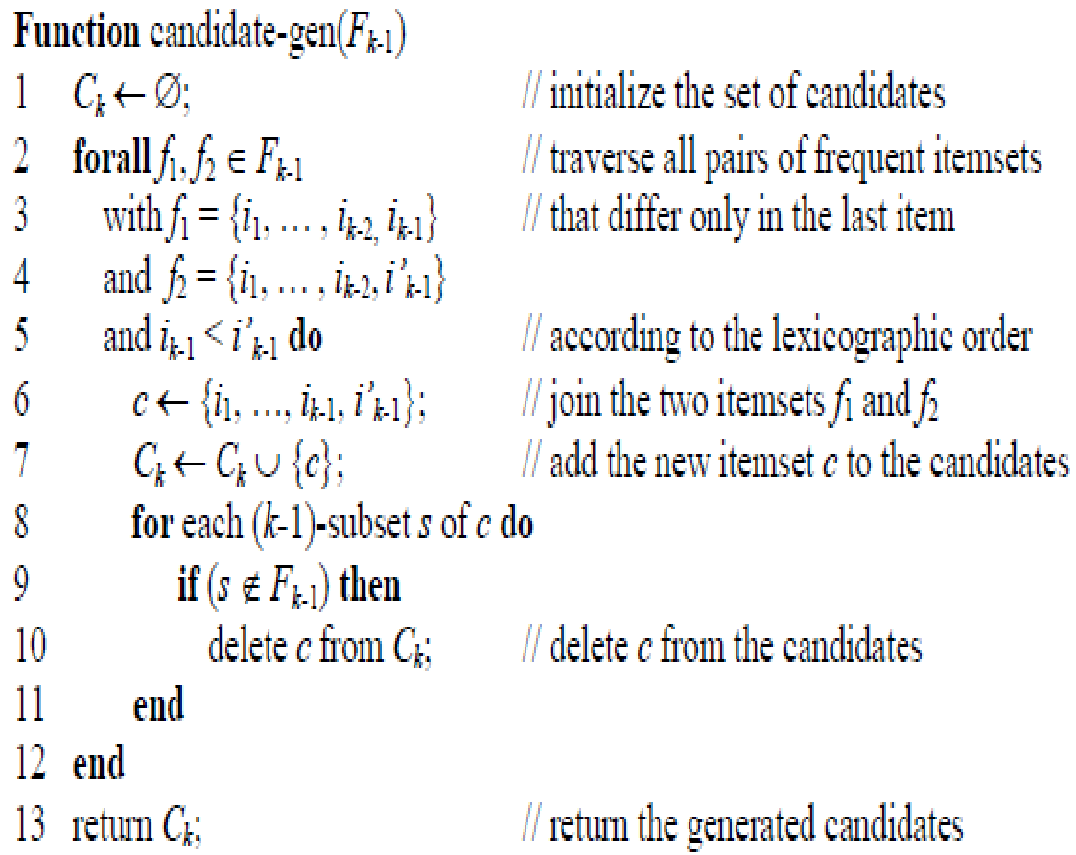
The Apriori Algorithm for generating all frequent itemsets

Slide 47
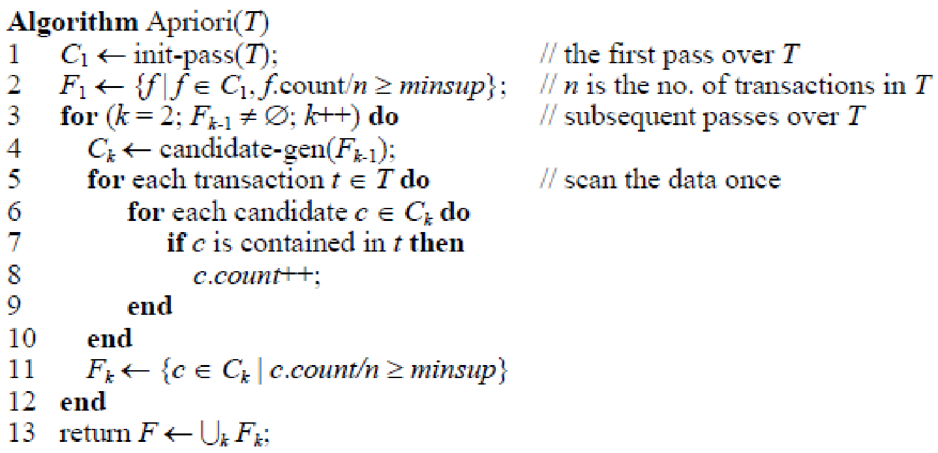
It is based on level-wise search

Slide 48
This algorithm is based on level-wise search.
It generates all frequent itemsets by making multiple passes over the data.
In the first pass, it counts the supports of individual items (line 1) and determines whether each of them is frequent (line 2).
F1 is the set of frequent 1-itemsets.
In each subsequent pass k, there are three steps:
1. It starts with the seed set of itemsets Fk-1 found to be frequent in the (k- 1)-th pass. It uses this seed set to generate candidate itemsets Ck (line 4), which are possible frequent itemsets. This is done using the candidate-gen() function.
2. The transaction database is then scanned and the actual support of each candidate itemset c in Ck is counted (lines 5-10). Note that we do not need to load the whole data into memory before processing. Instead, at any time, only one transaction resides in memory. This is a very important feature of the algorithm. It makes the algorithm scalable to huge data sets, which cannot be loaded into memory.
3. At the end of the pass or scan, it determines which of the candidate itemsets are actually frequent (line 11).

Slide 49
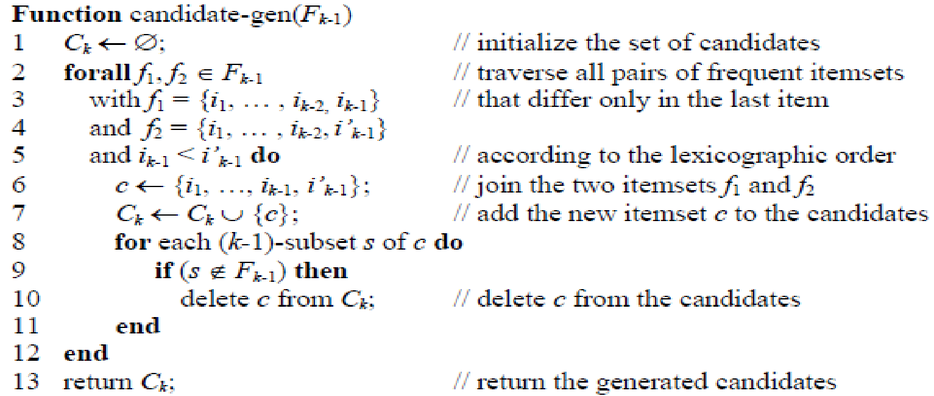

Slide 50
Candidate-gen function
The candidate generation function
the join step and the pruning step
Join step (lines 2-6):
This step joins two frequent (k-1)-itemsets to produce a possible candidate c (line 6).
The two frequent itemsets f1 and f2 have exactly the same items except the last one (lines 3-5).
c is added to the set of candidates Ck (line 7).
Pruning step (lines 8-11):
A candidate c from the join step may not be a final candidate.
This step determines whether all the k-1 subsets (there are k of them) of c are in Fk-1.
If anyone of them is not in Fk-1, c cannot be frequent according to the downward closure property, and is thus deleted from Ck.

Slide 51
Example (Candidate-gen function)
Let the set of frequent itemsets at level 3 be F3 = {{1, 2, 3}, {1, 2, 4}, {1, 3, 4}, {1, 3, 5}, {2, 3, 4}}
The join step (which generates candidates for level 4)
will produce 2 candidate itemsets, {1, 2, 3, 4} and {1, 3, 4, 5}.
{1, 2, 3, 4} is generated by joining the first and the second itemsets in F3 as their first and second items are the same respectively.
{1, 3, 4, 5} is generated by joining {1, 3, 4} and {1, 3, 5}.
After the pruning step,
we have only: C4 = {{1, 2, 3, 4}}
because {1, 4, 5} is not in F3 and thus {1, 3, 4, 5} cannot be frequent.

Slide 52
Complete running example of the Apriori Algorithm
based on the transaction
t1: Beef, Chicken, Milk t2: Beef, Cheese t3: Cheese, Boots t4: Beef, Chicken, Cheese t5: Beef, Chicken, Clothes, Cheese, Milk t6: Chicken, Clothes, Milk t7: Chicken, Milk, Clothes
We use minsup = 30%.
F1: {{Beef}:4, {Chicken}:5, {Clothes}:3, {Cheese}:4, {Milk}:4}
C2: {{Beef, Chicken}, {Beef, Clothes}, {Beef, Cheese}, {Beef, Milk}, {Chicken, Clothes}, {Chicken, Cheese}, {Chicken, Milk}, {Clothes, Cheese}, {Clothes, Milk}, {Cheese, Milk}}
F2: {{Beef, Chicken}:3, {Beef, Cheese}:3, {Chicken, Clothes}:3, {Chicken, Milk}:4, {Clothes, Milk}:3}
C3: {{Chicken, Clothes, Milk}}
Note: {Beef, Chicken, Cheese} is also produced in line 6 of Fig. 3. However, {Chicken, Cheese} is not in F2, and thus the itemset {Beef, Chicken, Cheese} is not included in C3.
F3: {{Chicken, Clothes, Milk}:3

Slide 53
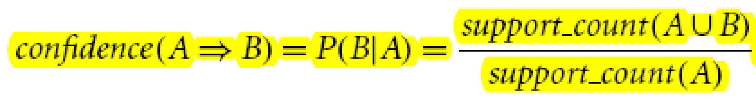
Generating Association Rules from Frequent Itemsets
Once the frequent itemsets from transactions in a database D have been found, it is straightforward to generate strong association rules from them (where strong association rules satisfy both minimum support and minimum confidence).
association rules can be generated as follows

Slide 54
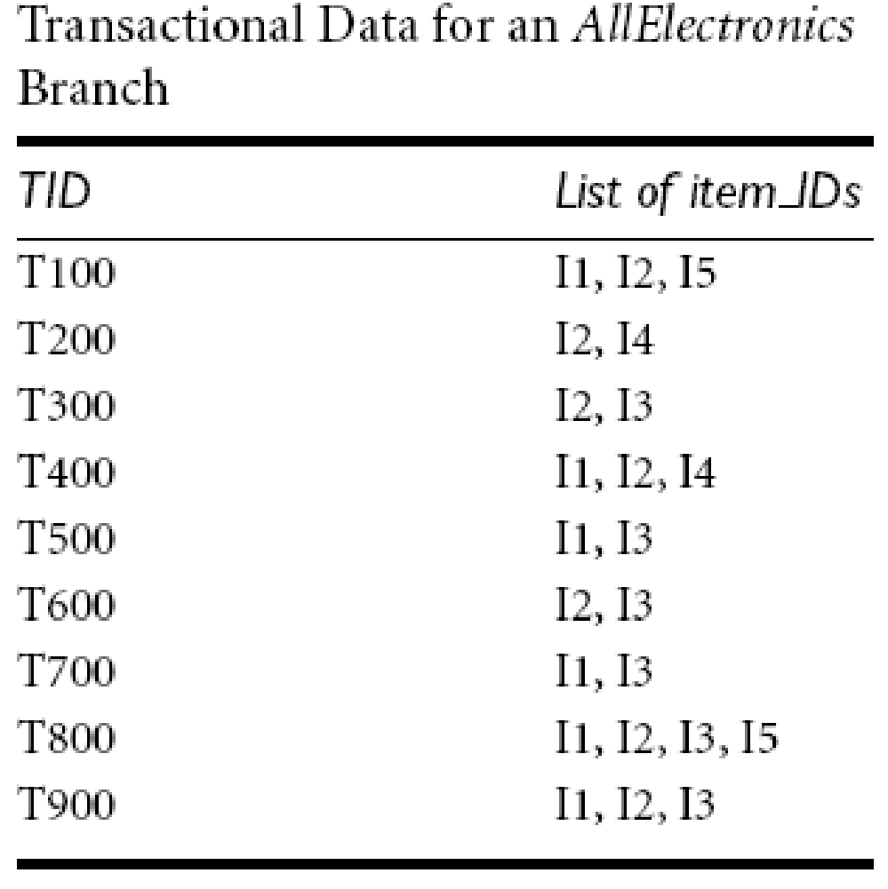

Slide 55
Association Rule Generation
To generate rules for every frequent itemset f, we use all nonempty subsets of f. For each such subset α, we output a rule of the form
(f − α) → α, if
Confidence ={ f.count/(f-α).count }≥minconf
where f.count and ((f−α).count) are the support count of f and ((f − α))
The support of the rule is
f.count/n, where n is the number of transactions in the transaction set T
Thus, no data scan is needed in rule generation
All the support counts needed for confidence computation are available
because if f is frequent, then any of its non-empty subset is also frequent and its support count has been recorded in the mining process.

Slide 56
Generating association rules: Example
Let’s try an example based on the transactional data for AllElectronics shown before in Table.
The data contain frequent itemset X= {I1, I2, I5}.
What are the association rules that can be generated from X?
The nonempty subsets of X are {I1, I2}, {I1, I5}, {I2, I5}, {I1}, {I2}, and {I5}.
The resulting association rules are as shown below, each listed with its confidence:
{I1, I2} →I5, confidence = 2/4 = 50%
{I1, I5} → I2, confidence = 2/2 = 100%
{I2, I5} → I1, confidence = 2/2 = 100%
I1 → {I2, I5}, confidence = 2/6 = 33%
I2 → {I1, I5}, confidence = 2/7 = 29%
I5 → {I1, I2}, confidence = 2/2 = 100%

Slide 57
If the minimum confidence threshold is, say, 70%, then only the second, third, and last rules are output, because these are the only ones generated that are strong.

Slide 58
This exhaustive rule generation strategy is, however, inefficient.
To design an efficient algorithm, we observe that the support count of f in the above confidence computation does not change as α changes.
It follows that for a rule (f − α) → α to hold, all rules of the form (f − αsub) → αsub must also hold, where αsub is a non-empty subset of α, because the support count of (f − αsub) must be less than or equal to the support count of (f − α).
For example, given an itemset {A, B, C, D}, if the rule (A, B → C, D) holds,
then the rules (A, B, C → D) and (A, B, D → C) must also hold.

Slide 59
Thus, for a given frequent itemset f, if a rule with consequent α holds, then so do rules with consequents that are subsets of α.
This is similar to the downward closure property that, if an itemset is frequent, then so are all its subsets.
Therefore, from the frequent itemset f, we first generate all rules with one item in the consequent.
We then use the consequents of these rules and the function candidate-gen() to generate all possible consequents with two items that can appear in a rule, and so on.

Slide 60
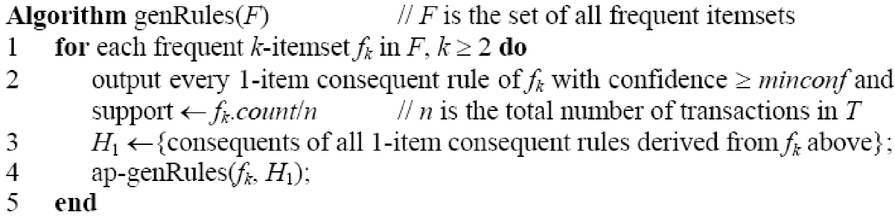
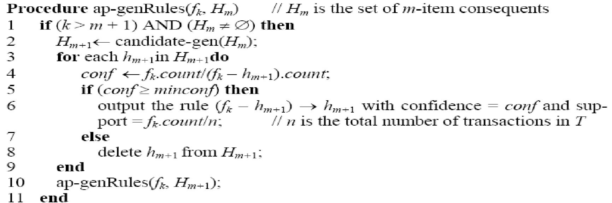
Association rule generation algorithm

Slide 61
Example
set of 7 transactions and minsup = 30% and minconf = 80%.
t1: Beef, Chicken, Milk
t2: Beef, Cheese
t3: Cheese, Boots
t4: Beef, Chicken, Cheese
t5: Beef, Chicken, Clothes, Cheese, Milk
t6: Chicken, Clothes, Milk
t7: Chicken, Milk, Clothes,
The frequent itemsets are as follows:
F1: {{Beef}:4, {Chicken}:5, {Clothes}:3, {Cheese}:4, {Milk}:4}
F2: {{Beef, Chicken}:3, {Beef, Cheese}:3, {Chicken, Clothes}:3, {Chicken, Milk}:4, {Clothes, Milk}:3}
F3: {{Chicken, Clothes, Milk}:3}

Slide 62
The itemset in F3 generates the following possible 1-item consequent rules:
Rule 1: Chicken, Clothes → Milk [sup = 3/7, conf = 3/3]
Rule 2: Chicken, Milk → Clothes [sup = 3/7, conf = 3/4]
Rule 3: Clothes, Milk → Chicken [sup = 3/7, conf = 3/3]
Note: generating rules from each itemset in F2 can be done in the same way
Due to the minconf requirement, only Rule 1 and Rule 3 are output in line 2 of the algorithm genRules().
Thus, H1 = {{Chicken}, {Milk}}. The function ap-genRules() is then called. Line 2 of ap-genRules() produces H2 ={{Chicken, Milk}}. The following rule is then generated:
Rule 4: Clothes → Milk, Chicken [sup = 3/7, conf = 3/3]
Thus, the following association rules are generated from the frequent itemset {Chicken, Clothes, Milk} in F3
Rule 1, Rule 3 and Rule 4.

Slide 63
Some remarks about Apriori Algorithm
Theoretically, this is an exponential algorithm.
Number of items-m
Space of all itemsets is O(2^{m})
However, the mining algorithm exploits the sparseness of the data and the high minimum support value to make the mining possible and efficient.
The sparseness of the data
in the context of market basket analysis means that
the store sells a lot of items, but each shopper only purchases a few of them.
This is true for text documents as well.
The set I, which is the vocabulary, is usually very large, but each document only contains a small subset of the words.

Slide 64
The algorithm can scale up to large data sets as it does not load the entire data into the memory.
It only scans the data K times, where K is the size of the largest itemset.
In practice, K is often small (e.g., < 10).
This scale-up property is very important in practice because many real-world data sets are so large that they cannot be loaded into the main memory.

Slide 65
The algorithm is based on level-wise search.
It has the flexibility to stop at any level.
This is useful in practice because in many applications, long frequent itemsets or rules are not needed as they are hard to use.

Slide 66
Once a transaction set T, a minsup and a minconf are given, the set of frequent itemsets that can be found in T is uniquely determined.
Any algorithm should find the same set of frequent itemsets.
This property about association rule mining does not hold for many other data mining tasks, e.g., classification or clustering, for which different algorithms may produce very different results

Slide 67
The main problem of association rule mining is that it often produces a huge number of itemsets (and rules), tens of thousands, or more, which makes it hard for the user to analyze them to find those truly useful ones.
This is called the interestingness problem.
Researchers have proposed several methods to tackle this problem
Apart from the Apriori algorithm, there is a large number of other algorithms, e.g., FP-growth and many others.

